Slide 1
Course Title: Economics Code: Eco. 155 BIT 2nd Semester
Presented by Hemanta Rai
Assistant Professor Economics
Patan Multiple Campus
Tribhuvan University

Slide 2
Unit: 5 Cost and Revenue
Concept of economic cost as a sum of Implicit cost and explicit cost, (accounting cost and economic cost, historical cost and replacement cost, separable cost and common cost, opportunity cost;) Short-run total costs (fixed and variable) and unit costs (average fixed, average variables, average total, and marginal) and their curves relationship between average variable, average, total and marginal cost, cost in the long-run; average and marginal costs causes of U-shaped and L-shaped long run average cost curve.
Concept of total, average and marginal revenues and their curves in the perfectly competitive and imperfectly competition markets, Relationship between revenue and price elasticity of demand.

Slide 3
Concept of costs:
Cost: it refers to the expenditures or spending on factors of production as they contributed in the production process. In other words it is the spending on compensation on employees, rent, interest, profit, buildings, raw materials, fuel and others.
We can separate the factors of production on the basis of ownership of the inputs as external factors of production (which are hired from other firms and individuals) and internal factors of production (which are own by owner her/him selves)
Explicit cost: it is the expenditures or spending on external factors of production. This cost incur as monetary terms and it is recorded by an accountant
Implicit cost: it is those expenditure or spending incur in the internal (owners own) factors of production. Those costs done not incur in the monetary terms but evaluated with the help of the opportunity cost.

Slide 4
Nature and function of profit:
Meaning of profit: Profit means the difference between cost and revenue
It is differs from persons like economist, businessman, accountant
Profit is the excess of income over expenditure.
Profit includes various economic concepts like opportunity cost, fixed cost, variable cost implicit cost, explicit cost and revenues.

Slide 5
Business Vs economic profit:
Accounting / Business profit
= TR – Explicit cost
Explicit cost is the cost paid for external factors of production.
Economic profit
= TR – (Explicit + Implicit cost) economic cost
Implicit cost refers to the cost incurred for self owned factors of production along with normal profit
TR= total revenue (P*Q)

Slide 6
Case I
Asha a beautician , working as a manager of a company for Rs 120000 per year, wants to start her own business by investing her own money of Rs. 400000 on which she can earn 10% interest if deposited in bank. Her estimated revenue during the first year of operation is Rs 300000 and costs are salaries to employees Rs 90000, supplies Rs 30000, rent Rs 20000 and utilities Rs 20000.
Questions
What is business profit? What is economic profit.
If she ask you whether to start business or not what will be your advice and why?
What will be your advice is if she could earn only 3% interest on her own money with deposited in bank?

Slide 7
Case 2
Rohan working in a bank earning Rs 15000 per month he has deposited Rs 480000 in a bank which yield 5% interest per annum. He wants to start his own business investing his money and work as a manager. He has estimated total revenue Rs 82000 per month and estimated cost of production raw material Rs 50000 per month, advertisement Rs 10000 annual depreciation 15% of capital worth Rs 200000, utilities 3000/ month, miscellaneous expenses Rs 8000.
Find
Business and economic profit
If Rohan asks whether to start business or continue job, what is your suggestions and why?

Slide 8
Cost function: it is a functional relationship between cost and factors determinants of cost (level of output Q, prices of factors of production (ie wage rate, interest rate, rent ), technological development etc) the main factor determinants of cost of level of output so the relationship between cost and level of output is known as cost function.
C=f(Q)
Short-run cost curves:
Short run is that time period in which producer cannot change all the factors of production as he required. So in the short run some factors of production remains fixed and some factors of production can be changed.
The expenses/expenditure over the fixed factors of production is called fixed cost and the expenses over variable factors of production is called variable cost.

Slide 9
Derivation of short sun total cost curves: the behaviour of short run cost can be explain with the help of the following table.
a. Total fixed cost: the cost which is paid to the fixed factors of production is called fixed cost. Expenditure made to the machinery, land building etc are the example of fixed cost. The aggregate of the cost of all the factors of production is define as the total fixed cost TFC. Whatever be the level of output, TFC remains constant and positive
Output in units | TFC | TVC | TC=TFC+TVC
0 | 20 | 0 | 20
1 | 20 | 10 | 30
2 | 20 | 18 | 38
3 | 20 | 24 | 44
4 | 20 | 32 | 52
5 | 20 | 50 | 70
6 | 20 | 110 | 130
7 | 20 | 250 | 270
Cost
TFC
O
Output

Slide 10
b. Total variable cost: the cost which is incurred to the variable factors is known as variable cost. Labour cost, raw material cost etc are the variable costs. The aggregate of the cost of variable factors is the total variable cost. At the zero level of output TVC equals to zero. Initially TVC increases at a decreasing rate after that in increases at an increasing rate along with increase in output due to the application of law of variable proportion.
TVC
cost
O
Output

Slide 11
c. Total cost (TC): the sum of total fixed cost and total variable cost is called total cost. TC starts from the origin of TFC curve and the slope of TC is same as that of TVC. TC=TFC+TVC
TC
TVC
Cost
cost
TFC
O
Output
Output

Slide 12
Derivation of short run Average and Marginal costs: basically there are three types of short run average costs a. Average fixed cost (AFC)
b. Average Variable cost (AVC)
c. Average cost (AC)
Output in units | TFC | TVC | TC=TFC+TVC | AFC=TFC/Q | AVC=TVC/Q | AC=YC/Q or AFC+AVC | MC=dTC/dQ MC=TCn-TCn-1
0 | 20 | 0 | 20 | - | - | - | -
1 | 20 | 10 | 30 | 20 | 10 | 30 | 10
2 | 20 | 18 | 38 | 10 | 9 | 19 | 8
3 | 20 | 24 | 44 | 6.67 | 8 | 14.67 | 6
4 | 20 | 32 | 52 | 5 | 8 | 13 | 8
5 | 20 | 50 | 70 | 4 | 10 | 14 | 18
6 | 20 | 110 | 130 | 3.33 | 18.33 | 21.67 | 60
7 | 20 | 250 | 270 | 2.83 | 35.73 | 38.57 | 140

Slide 13
Average fixed cost (AFC): it is the outcome of total fixed cost divided by the quantity of output produced. It is also called the per unit of fixed factors of output produced, when output increases it falls continuously at diminishing rate. AFC=TFC/Q
Average variable cost (AVC): it is the outcome of total cost divided by the number of output produced. It is also called per unit cost of the variable factor of production. AVC=TVC/Q
Average cost (AC): it is the outcome of the total cost divided by the units of quantity produced. It is also called the average total cost (ATC). AC=TC/Q or TC=TFC+TVC so TFC/Q+TVC/Q=AFC+AVC
Marginal cost (MC): it is the additional cost made to the total cost while one more unit of output is produced. In other words, it is the ratio of change in total cost variable cost resulting from change in output. MC=dTVC/dQ or dTC/dQ
or MC = TVC – TVC or MC= TC – TC

Slide 15
AC, AVC and MC

Slide 16
Short run AC, AVC, AFC and MC
Cost
SMC
AC
AVC
AFC
O
Output

Slide 17
Relationship between production function and cost function
The cost function is derived from production function.
MP
AP
MP
AP
Output
Output
MC
MC
AC
O
Output
Output

Slide 18
Relation
AP,MP
AP
O
Output
MP
AC,MC
MC
AC
O
Output

Slide 19
Relationship between AC and MC: initially both AC and MC decrease, but rate of decrease in MC is greater than AC, so MC lies below AC. MC intersect at the minimum point of AC from the below. At the intersecting point both AC and MC are equal. After minimum of AC, MC become higher then AC.
Costs
MC
AC
a
O
Q
Output

Slide 20
Contd…
The relationship between AC and MC are as follows
Both AC and MC are derived from total cost i.e. AC=TC/Q, MC=dTC/dQ
When AC falls, MC also falls but the rate of fall in MC is greater than the rate of fall in AC in figure left to point a, AC>MC
Both are U-shaped due to law of variable proportions
When AC increases, MC also increases but the rate of increase in MC is greater than the rate of increase in AC. In figure right to the point a AC < MC
MC always cuts AC at its minimum point from the below.

Slide 21
Relationship between AC (ATC) and AVC:
Both AC and AVC both are U-shaped. AC is the TC divided quantity of output and AVC is TVC divided by total quantity of output. The AVC is a part of AC. AC=AFC+AVC. With the figure
AC (ATC)
Cost
AVC
M2
M1
AFC
O
Q1
Q2
Output

Slide 22
Contd..
The relationship between AC and AVC is pointed out as follows
Both AC and AVC curves are U-shaped, reflecting the law of variable proportion.
The minimum point of AC is right of minimum point of AVC
AC is above AVC (AC>AVC) because AVC is a part of AC. In other words, AC is derived by the sum of AVC and AFC.
At the beginning, both AC and AVC decline. After reaching the minimum point, both increase.
Since, AFC falls continuously with increase in output, AVC approaches near to AC, in other words, distance between AVC and AC decreases as output increase because of decline in AFC.

Slide 23
Questions for discussion:
The total cost function of a producer is given as C=868+47Q+0.5Q². find the TFC, TVC, AFC, AVC and MC to produce 12 unit of output.
Complete the table and draw the figures. And using the table and figures explain the relationship between AFC, AVC and AC
output | TFC | TVC | TC | AFC | AVC | AC (ATC) | MC
0 | 100 | -
1 |  | 50
2 |  | 90
3 |  | 120
4 |  | 140
5 |  | 175
6 |  | 230
7 |  | 310
8 |  | 400

Slide 24
3. Complete the following table and explain the relationship between AC, AVC and MC
Output (Q) | TVC | TFC | TC | AFC | AVC | AC | MC
0 | 0 |  | 100
1 | 10
2 |  |  |  |  |  |  | 8
3 |  |  |  |  | 8
4 |  |  | 132
5 |  |  |  |  |  | 30
6 | 80
7 |  |  |  |  |  |  | 44
8 |  |  |  |  | 22.5
9 | 260

Slide 25
Long run average cost curve:
Long run refers to that time period in which producer is able to change factors of production as their will.
The long rung average cost is the per unit cost of factors of production in the long run.
It is the outcome of the long run total cost divided by the total quantity produced.
It indicates the lowest cost of production at each level of output when all inputs have been adjusted.
It is derived by joining all the relevant points of the short run average cost when the firm can shift from one plant to another plant.

Slide 26
How producer can changed the plant?
Let us assume that the initial market demand is Q1. the firm operates the small scale plant to meet this level of output. When market demand increases from Q1 to Q2 and up to Q3, the firm still operate same plant. But is the firm expects that future demand will increase further Q3 to Q4 it will install the next plant medium scale plant because the output is produced at a lower cost bQ4 on SAC2 as compare to cQ4, on SAC1. hence, firm will produce every level of output more than Q3 to Q5 due the lower cost of production. By the same logic for producing more than Q5 level of output the producer install large plant SAC3. In this way firm changes their plants.
cost
SAC1
SAC2
c
SAC3
a
d
f
b
e
O
Q1
Q2
Q3
Q4
Q5
Q6
Output

Slide 27
From the above analysis, it can be concluded that the producer will operate only on the portions below the intersection of various SAC curves.
It is also clear that there are very large number of plants, each producing different level of output.
LAC curves will smooth and continuous curve without any bumps.
In short producer always tries to produce any level of output by operating any size of plant at minimum cost points or possible minimum cost points
SAC1
SAC2
SAC5
SAC4
LAC
Cost
SAC3
O
Q1
Q2
Q3
Q4
Q5

Slide 28
Contd…
LAC is derived by joining or tangenting the minimum points, or the possible minimum costs of plants which can be brought under the operation in the short run production. Hence, it is also called tangent curve.
It is also called the envelop curve because is encloses (or envelops) the whole family of short run cost curves.
It is also termed decision making curve because on the basis of this curve that the firm decides what plant to set up in order to produce the expected level of output at minimum cost.
Firm makes a plan about plant size and level of output with the help of LAC. Hence, it is also called Planning curve.

Slide 29
Why LAC slopes U-shaped?
Because of operation of the law of returns to scale. Thus
When increasing returns to scale operates, the average product increases and the average cost decrease
When decreasing returns to scale operates, the average product decrease and the average cost increases
Due to the operation of constant returns to scale, the average product becomes maximum and constant and average cost becomes minimum and constant.
LAC is less pronounced (or more flatter) than SACs. Because:
The degree of economics of scale in long run is greater than degree of economies of scale in short run.
The degree of diseconomies of scale is less than the degree of diseconomies of scale in the short run

Slide 30
Derivation of long run Marginal cost (LMC) curve:
LMC is derived from the short run marginal cost curves.
LMC must be equal to SMC for the output at which the corresponding SAC is tangent to the LAC.
These tangency points help to determined the level of output at different levels of plant capacity.
SMC3
Here in the figure if we draw
Vertical lines from these points
a, b, and c to the X-axis the
Corresponding output levels
Well be Q1, Q2 and Q3, the
Vertical line intersect SMC1 at d,
Where LMC is dQ1. when output
Expands to Q2, the marginal cost will be bQ2, (where bQ2, vertical line tangents
SMC2 at b point). Similarly if the vertical line cQ3 extended to SMC3 at point e. thus eQ3 is the LMC at output Q3. when we join d,b and e we get LMC.
LMC
SMC1
e
SAC3
SAC1
SAC2
LAC
Cost
a
c
SMC2
d
b
O
Q1
Q2
Q3
Output

Slide 31
The L-Shaped scale curve or L-Shaped long run average curve (or Empirical Evidence of LAC):
We know all costs are variable in the long run.
The cost may be distinguished into production costs and managerial costs.
The production costs fall continuously with increases in output, whereas at very large scale of output managerial costs may rise. But the fall in production costs outweighs the increase in managerial costs, so that the LAC falls with increases in output.
Production cost fall steeply in the beginning and then gradually as the scale of production increases
the L-shape of production cost curve is explained by the technical economies of scale.
Initially these economies are substantial. The firm reaches point at which opportunities for economies of scale are exhausted average cost fall further.
The level of output beyond which production costs stop falling is called the minimum efficient scale (MES)

Slide 32
L-shape LAC
Cost
MES
LAC
O
Q
Output

Slide 33
In other words L-shape LAC becomes because even in the large scale production there is no more diseconomies of scale than economies of scale. Initially economies of scale is large greater than diseconomies of scale is LAC falls more after certain level of output diseconomies of scale increase but is never excess than economies of scale rather it becomes some lower.
Because
From the further decentralization and improvement in skill
If the firm reaches a certain size the firm may attain lower repair costs.
Especially if it is a multi-product firm instead of buying them others, may use itself the production of some of the materials which it requires.
In modern management science, we find various level of management in an organization, each with its appropriate kind of management technique. It is appreciable to a range of output.

Slide 34
Meaning and types of revenue
Revenue refers to the sales receipts that a firm receives after selling the output at a given price. It three elements
Total Revenue (TR): it is defined as the total sales receipts that a firm receives from the sale of its products, total revenue can be computed in two ways a. TR=Q*P b.TR=∑MR=MR1+MR2+ ……… +MRn
Average Revenue (AR): it is the outcome of the total revenue divided by the total output. In other words, it is per unit price. AR=TR/Q OR AR=Q*P/Q AR=P
Marginal Revenue (MR): it is the ratio of change in total revenue with change in the total sales quantity. It is also define as the addition made to the total revenue by selling one more unit of the output. MR=dTR/dQ, or MR=TRn – TRn-1

Slide 35
Revenue under perfectly competition:
Perfect competition refers to a market situation in which there are large numbers of buyers and sellers of homogenous product. The price of the product is determined by the interaction between forces of market, demand and supply. A firm is price taker. Thus it sells its output at the prevailing market price over a period of time.
Under the perfect competition, TR varies positively and proportionately with output at constant price but both AR and MR remain constant at any level of output.
At constant price, TR increases at a constant rate as output increases (TR varies positively and proportionately with)

Slide 36
Output | Price | TR | AR | MR
1 | 40 | 40 | 40 | 40
2 | 40 | 80 | 40 | 40
3 | 40 | 120 | 40 | 40
4 | 40 | 160 | 40 | 40
Table
Relation between TR and MR:
Since TR varies positively and proportionately with output, MR remains constant. In other words, MR shows the rate of change in TR with respect to change in output i.e MR=dTR/dQ. Hence MR remains constant when TR increases at a constant rate
Price and Revenue
TR
P
AR=MR=P
O
Output

Slide 37
Revenue under Imperfect competition:
Besides perfect competition all the market structures (monopoly, monopolistic, oligopoly and others) are known as imperfectly competitive market structure.
In those market structures firm has market power or firm is price maker (who determines the price of his product on the basis of the law of demand)
Thus, the seller can sell more units of the output only at lower prices. In other words there is inverse relationship between output and price.
Hence, under imperfect competition, total revenue increases at a diminishing rate with increase in output at same rate. but both average and marginal revenue fall continuously. However the decreasing rate of marginal revenue is greater than average.

Slide 38
Table of revenue curves under Imperfect competition.
Note:
Under monopoly, firm has full control over its supply. It can determine price of the product by itself on the basis of law of demand. Hence firm is price maker.
Due to differentiated product and imperfect knowledge about the market, firms can enjoy the monopoly power on their product. Hence, they determine their price of product by themselves
 | Output | Price | TR=P*Q | AR | MR=dTR/dQ | Ep=dQ/dp*P/Q
A | 1 | 16 | 16 | 16 | 16
B | 2 | 14 | 28 | 14 | 12
C | 3 | 12 | 36 | 12 | 8
D | 4 | 10 | 40 | 10 | 4
E | 5 | 8 | 40 | 8 | 0
F | 6 | 6 | 36 | 6 | - 4

Slide 39
Curves
Total revenue
TR
O
Q
Output
MR, AR
AR=D
O
Q
Output
MR

Slide 40
Relationship between AR and MR:
Under perfect competition, price remains constant for firm as output increases. Hence, when AR curve slope horizontal or parallel to X-axis, then MR curve coincides with AR curve.
Under imperfect competition, AR curve slopes downwards to the right (or as a linear form), the MR curve will cut any line perpendicular drawn to the Y-axis halfway from the average revenue curve. It is due to the fall in price at same proportion (10,9,8,7)at any level of output.
Under imperfect AR curve slope downwards to the right as convex to the origin, the MR curve will cut any line perpendicular drawn to the Y-axis more than half way from the AR curve. It happens when price falls at a diminishing rate (10,7,5,4) with an increase in output at same proportion
When AR curve slope downwards to the right as concave to the origin, the MR curve will cut any line perpendicular drawn to the Y-axis at half way from the average revenue curve. It happens if price falls at an increasing rate (10,9,7,4) with increase in output at same proportion.

Slide 41
Relationship between AR and MR
1. At perfect competition
2. At imperfect competition, when AR, MR is linear
AR, MR
AR, MR
P
AR=MR
AR=D
O
Output
O
Output
MR

Slide 42
Relationship between AR and MR
3. At imperfect competition, when AR is convex to the origin
4. At imperfect competition, when AR, MR is concave to the origin
AR, MR
AR, MR
AR=D
AR
MR
MR
O
Output
O
Output
MR

Slide 43
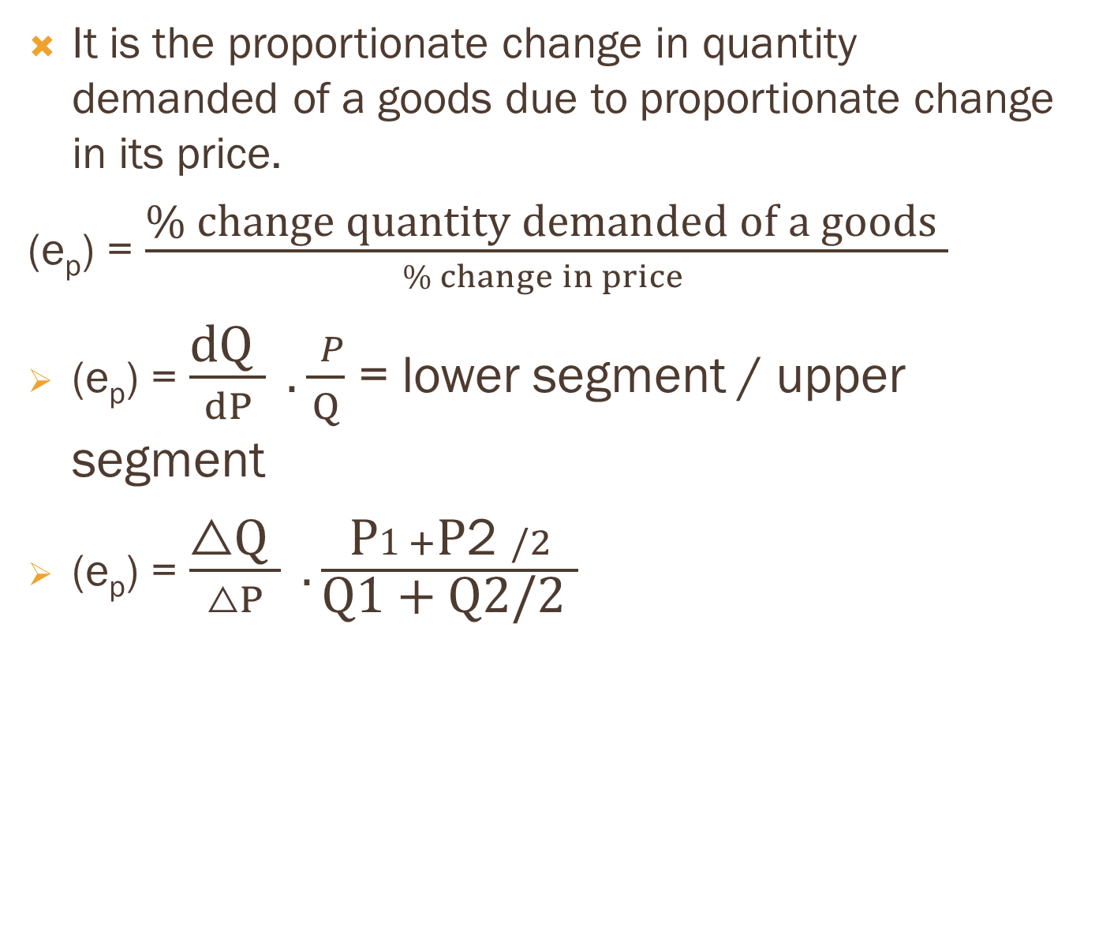
Price elasticity of demand:
It is the proportionate change in quantity demanded of a goods due to proportionate change in its price.
(e_{p}) = $\frac{\text{\% }\text{change} \text{quantity} \text{demanded} \text{of} \text{a} \text{goods} }{\% change in price }$
(e_{p}) = $\frac{\text{dQ} }{dP} .\frac{ P}{Q}$ = lower segment / upper segment
(e_{p}) = $\frac{\text{△}\text{Q} }{△P} .\frac{\text{P}1+\text{P}\text{2} /2}{\text{Q}\text{1 + }\text{Q}\text{2/2} }$

Slide 44
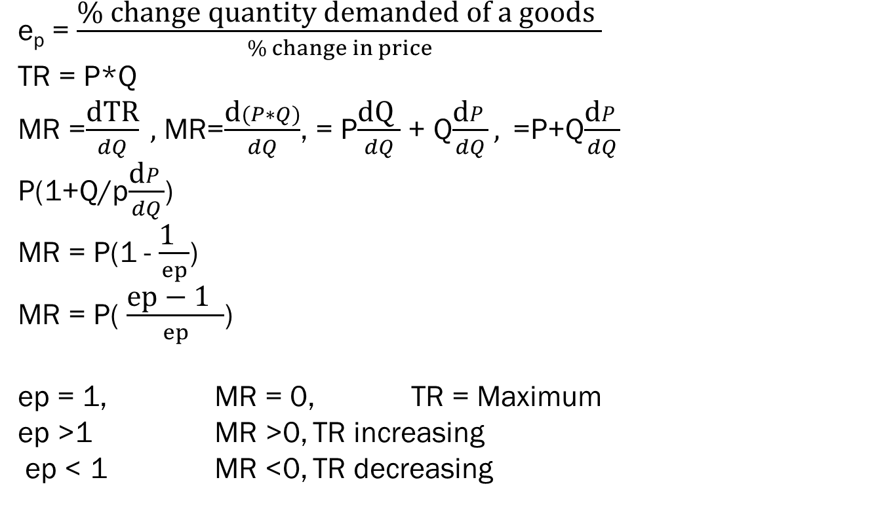
Relationship between price, price elasticity and revenue:
e_{p} = $\frac{\text{\% }\text{change} \text{quantity} \text{demanded} \text{of} \text{a} \text{goods} }{\% change in price}$
TR = P*Q
MR =$\frac{\text{dTR}}{dQ} ,$ MR=$\frac{\text{d}(P∗Q)}{dQ}$, = P$\frac{\text{dQ} }{dQ}$ + Q$\frac{\text{d}P}{dQ},$=P+Q$\frac{\text{d}P}{dQ}$
P(1+Q/p$\frac{\text{d}P}{dQ}$)
MR = P(1 - $\frac{\text{1 } }{ep}$)
MR = P( $\frac{\text{ep}\text{ − 1 } }{ep}$)
ep = 1, MR = 0, TR = Maximum
ep >1 MR >0, TR increasing
ep < 1 MR <0, TR decreasing

Slide 45
TR
TR maximum
a
0
Output
Q
TR
AR,MA
ep.>1
Ep=1
ep<1
MR>0
AR
0
Q
Output
MR=0
MR<0
MR

